Slide 1
PPT ON TECHNICAL SKILLS
-22A81A05I9(S.MAHATHI)
-22A81A05G0(K.PALLAVI DURGA)

Slide 2
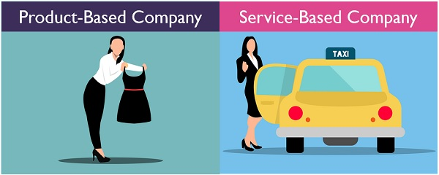
Service-based: those that do not provide goods but offers to SERVICES costumers
PRODUCT BASED:
IT IS AN ORGANISATION THAT MANUFACTURES AND MARKETS SPECIALIZED PRODUCTS TO CATER TO THE SPECIFIC NEEDS OF A VAST GROUP OF CONSUMERS

Slide 3
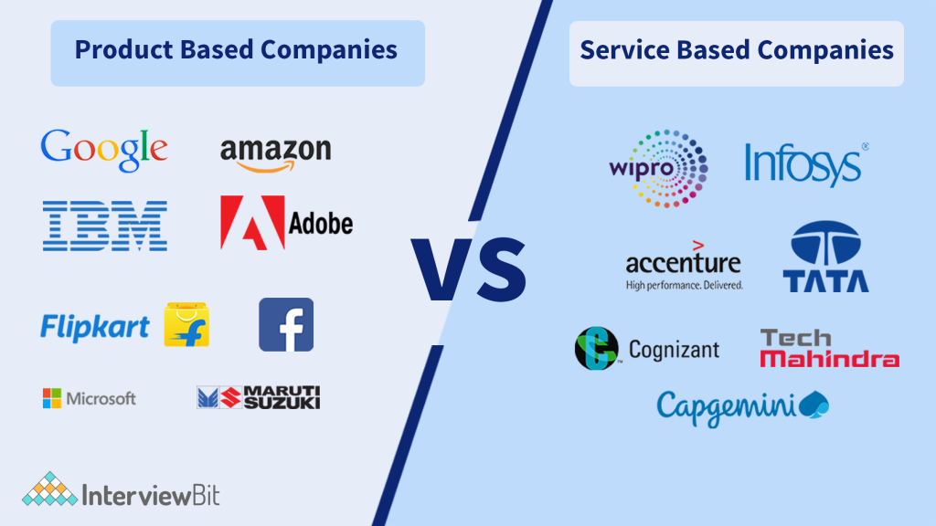

Slide 4
SD
WD
CS
TESTER
DOC
FIELDS OF SOFTWARE:

Slide 5
SD(SOFTWARE DEVELOPMENT):
Must and Should know any one language in Depth
C,C++,JAVA,Python,etc....
Practising more on problem solving skills
WD(WEB DEVELOPMENT):
The Building and Maintaining of websites
the three main types are:Front end,Back end,Full stack
HTML,CSS,JAVASCRIPT OR PHP

Slide 6
CS(Cyber Security):
Protection of systems,networks,programs from digital attacks
It saves from Hacking
TESTER:
IT Detects errors in given SD
There are tools to this work
DOC:
They saves the code if the code is lost then the saved code helps
Document Typing

Slide 7
CODING WEBSITES FOR PRACTISING:
Geeks for Geeks
Coding ninjas
JAVA Tutorial
Hackerrank
Hackerearth
Leet code

Slide 8

CERTIFICATIONS:
NPTEL(National Programme on Technology Enhanced LEARNING)
MICROSOFT AZURE
AWS CERTIFIED DEVELOPER(Amazon Web Services)
DEVOPS
GITHUB
CLOUDCOMPUTING,ETC……………..

Slide 9

EXAMPLES OF MINI PROJECT:
POMODORO TIMER
CALENDER
ALARAM TOOL
SIMPLE CALCULATOR
PSEUDO GAME
SNAKE GAME,ETC……….

Slide 10
THANK YOU
-22A81A05I9(S.MAHATHI)
-22A81A05G0(K.PALLAVI DURGA)

